Slide 1
Modern Data Warehouse
Samwel Kipkemboi
Data Analyst | BI | Business Technology
Tools: SQL Server, ETL, Star Schema

Slide 2
Business Problem
Data stored in multiple operational systems (CRM and ERP) causes slow, inconsistent reporting that delays business decisions. Hence, no single source of truth for decision making
Business insights are delayed and unreliable

Slide 3
Project Objective
Build a centralized, analytics-ready data warehouse integrating CRM and ERP sales data.
Enable consistent, reliable reporting for business decision-making enabling faster reporting and decision-making
Apply Medallion Architecture for structured data layers
Implement data cleansing, standardization, and transformation

Slide 4
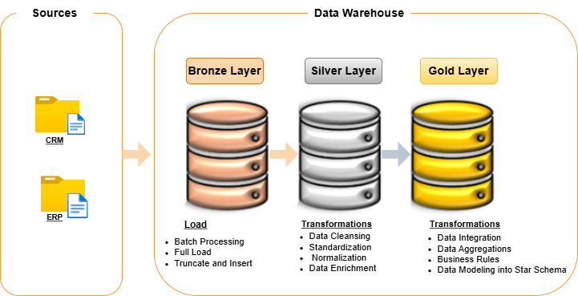
Architecture Overview
Bronze Layer: Raw data ingestion
Silver Layer: Cleaned and standardized data
Gold Layer: Analytics-ready data models
Supports scalable BI and reporting
Data Sources Include CRM and ERP system data

Slide 5
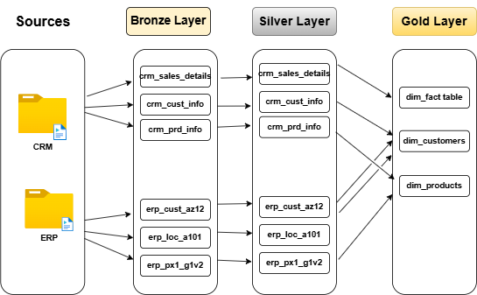
ETL Pipeline
Perform full data loads to populate Bronze and Gold layers
Extract data from source systems
Load raw data into Bronze layer
Transform and clean data in Silver layer
Model and aggregate into Gold layer
Automation
Use stored procedures to automate ETL steps
Scheduled to run weekly to maintain up-to-date warehouse

Slide 6
Data Quality Approach
Develops Data Quality Checks;
Completeness checks
Accuracy validation
Consistency enforcement
Only validated data moves to analytics layer

Slide 7
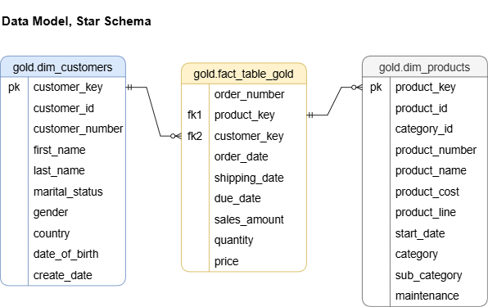
Data Modeling
Star schema implementation
Fact table for transactions
Dimension tables for customers and products
Optimized for analytics and BI queries

Slide 8
Tools & Technologies
SQL Server
SQL Server Management Studio (SSMS)
Draw.io for architecture design
GitHub for version control
Trello for project tracking

Slide 9
Challenges and Solutions
Messy source data → implemented cleansing logic
Inconsistent formats → standardized transformation rules
Integration complexity → structured schema design
Business Value
Centralized and reliable reporting
Faster decision-making
Consistent KPIs across departments
Improved trust in data

Slide 10
Future Improvements
Automate ETL pipelines
Cloud migration (Azure )
Real-time data ingestion
Dashboard integration (Power BI)

Slide 11
Conclusion
This project bridges business needs with technical solutions
Enables analytics, reporting, and decision support
It bridges operational systems (CRM and ERP) with a BI-ready reporting environment.
Ready for production level BI environments

Slide 12
Questions?

Slide 13
Thank you
SAMWEL KIPKEMBOI
Email: samkemboi201@gmail.com

